Slide 1
GRADE 7 ACCELERATED · UNIT 4 · LESSON 1
Adding and Subtracting in Scientific Notation
MA.8.NSO.1.5
I can add and subtract two numbers written in scientific notation, and write the answer in scientific notation.
Grade 7 Accelerated · Unit 4 · Lesson 1 — Adding and Subtracting in Scientific Notation
1

Slide 2


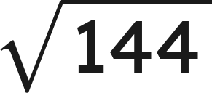

Warm-Up
1. Write 0.00062 in scientific notation.
2. How many times larger is
than
?
3. Find the value:
4. Find the sum:
Grade 7 Accelerated · Unit 4 · Lesson 1 — Adding and Subtracting in Scientific Notation
2

Slide 3
Warm-Up
1. Write 0.00062 in scientific notation.
6.2 × 10⁻⁴
2. How many times larger is
than
?
4,000
3. Find the value:
12
4. Find the sum:
1.69
Grade 7 Accelerated · Unit 4 · Lesson 1 — Adding and Subtracting in Scientific Notation
3

Slide 4
Notes
I. A power of ten is a place value
10³ | 10⁴ | 10⁵ | 10⁶
thousands | ten thousands | hundred thousands | millions
Two numbers can be added only when they carry the same power of ten.
Grade 7 Accelerated · Unit 4 · Lesson 1 — Adding and Subtracting in Scientific Notation
4

Slide 5
Notes
II. Same power: add or subtract the coefficients
Add or subtract the coefficients. The power of ten does not change.
Then check the coefficient: if it is not between 1 and 10, the answer is not finished.
Grade 7 Accelerated · Unit 4 · Lesson 1 — Adding and Subtracting in Scientific Notation
5

Slide 6
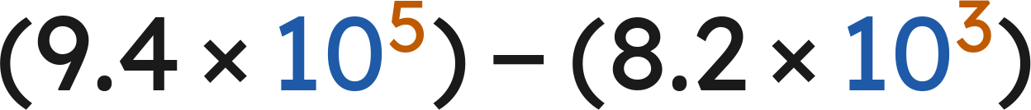

Notes
III. Different powers: rewrite one of them first
, never
Rewrite one number so both carry the same power of ten, then add or subtract the coefficients.
Exponent up one, decimal point one place left. The value does not move.
Grade 7 Accelerated · Unit 4 · Lesson 1 — Adding and Subtracting in Scientific Notation
6

Slide 7
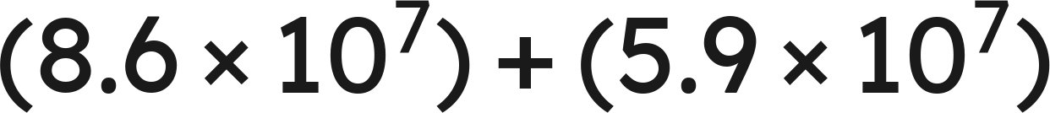
Example 1
Add. Write the answer in scientific notation.
Grade 7 Accelerated · Unit 4 · Lesson 1 — Adding and Subtracting in Scientific Notation
7

Slide 8
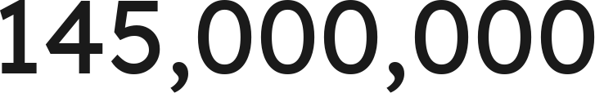
Example 1
Answer: 1.45 × 10⁸
Grade 7 Accelerated · Unit 4 · Lesson 1 — Adding and Subtracting in Scientific Notation
8

Slide 9
Your Turn
Add. Write the answer in scientific notation.
Grade 7 Accelerated · Unit 4 · Lesson 1 — Adding and Subtracting in Scientific Notation
9

Slide 10

Your Turn
Add. Write the answer in scientific notation.
Same power, so add the fronts:
Answer: 1.23 × 10⁻²
Grade 7 Accelerated · Unit 4 · Lesson 1 — Adding and Subtracting in Scientific Notation
10

Slide 11
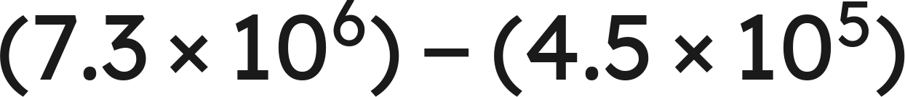
Example 2
Subtract. Write the answer in scientific notation.
Grade 7 Accelerated · Unit 4 · Lesson 1 — Adding and Subtracting in Scientific Notation
11

Slide 12
Example 2
Answer: 6.85 × 10⁶
Grade 7 Accelerated · Unit 4 · Lesson 1 — Adding and Subtracting in Scientific Notation
12

Slide 13
Your Turn
Subtract. Write the answer in scientific notation.
Grade 7 Accelerated · Unit 4 · Lesson 1 — Adding and Subtracting in Scientific Notation
13

Slide 14


Your Turn
Subtract. Write the answer in scientific notation.
Match the powers:
Answer: 5.51 × 10⁻⁴
Grade 7 Accelerated · Unit 4 · Lesson 1 — Adding and Subtracting in Scientific Notation
14

Slide 15
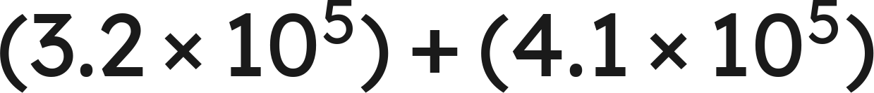
Whiteboards · Question 1 of 9
Answer it.
Grade 7 Accelerated · Unit 4 · Lesson 1 — Adding and Subtracting in Scientific Notation
15

Slide 16



Whiteboards · Question 1 of 9
Same power, so add the fronts:
Answer: 7.3 × 10⁵
Grade 7 Accelerated · Unit 4 · Lesson 1 — Adding and Subtracting in Scientific Notation
16

Slide 17


Whiteboards · Question 2 of 9
A stadium sold
tickets on Friday
and
on Saturday. Each ticket cost 38 dollars.
How many tickets were sold on the two days?
Answer it.
Grade 7 Accelerated · Unit 4 · Lesson 1 — Adding and Subtracting in Scientific Notation
17

Slide 18




Whiteboards · Question 2 of 9
A stadium sold
tickets on Friday
and
on Saturday. Each ticket cost 38 dollars.
How many tickets were sold on the two days?
Same power, so add the fronts:
Answer: 7.7 × 10⁴
Grade 7 Accelerated · Unit 4 · Lesson 1 — Adding and Subtracting in Scientific Notation
18

Slide 19
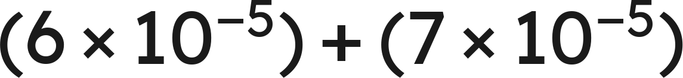
Whiteboards · Question 3 of 9
Answer it.
Grade 7 Accelerated · Unit 4 · Lesson 1 — Adding and Subtracting in Scientific Notation
19

Slide 20
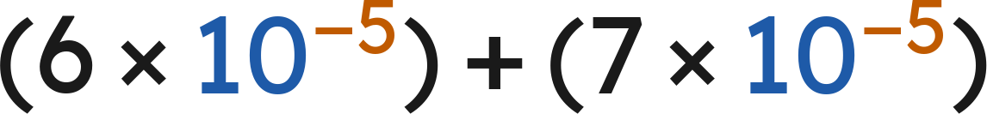

Whiteboards · Question 3 of 9
Answer: 1.3 × 10⁻⁴
Grade 7 Accelerated · Unit 4 · Lesson 1 — Adding and Subtracting in Scientific Notation
20

Slide 21
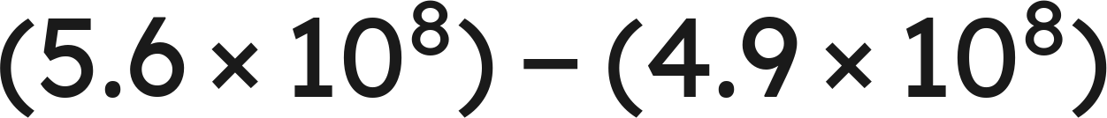
Whiteboards · Question 4 of 9
Answer it.
Grade 7 Accelerated · Unit 4 · Lesson 1 — Adding and Subtracting in Scientific Notation
21

Slide 22
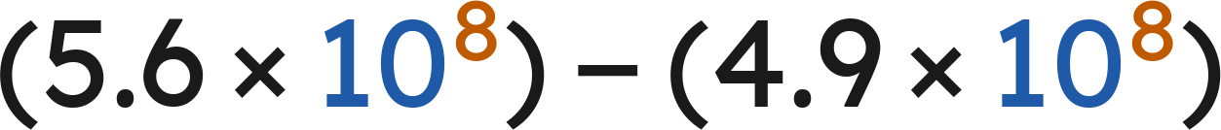


Whiteboards · Question 4 of 9
Answer: 7 × 10⁷
Grade 7 Accelerated · Unit 4 · Lesson 1 — Adding and Subtracting in Scientific Notation
22

Slide 23
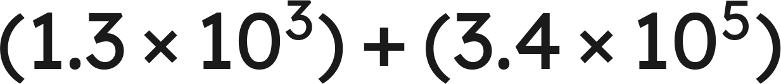
Whiteboards · Question 5 of 9
Which is the sum?
A. 4.7 × 10⁵
B. 4.7 × 10⁸
C. 3.413 × 10⁵
D. 3.53 × 10⁵
Answer it.
Grade 7 Accelerated · Unit 4 · Lesson 1 — Adding and Subtracting in Scientific Notation
23

Slide 24


Whiteboards · Question 5 of 9
Which is the sum?
Match the powers:
Answer: C — 3.413 × 10⁵
Grade 7 Accelerated · Unit 4 · Lesson 1 — Adding and Subtracting in Scientific Notation
24

Slide 25
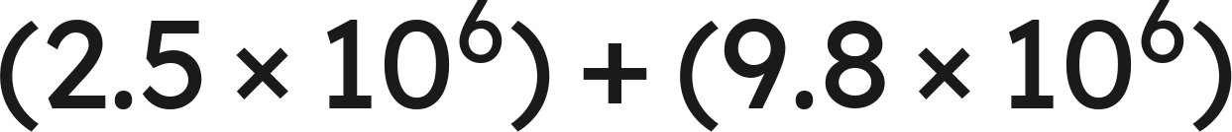
Whiteboards · Question 6 of 9
Which is the sum, written in scientific notation?
A. 12.3 × 10⁶
B. 12.3 × 10¹²
C. 1.23 × 10⁶
D. 1.23 × 10⁷
Answer it.
Grade 7 Accelerated · Unit 4 · Lesson 1 — Adding and Subtracting in Scientific Notation
25

Slide 26
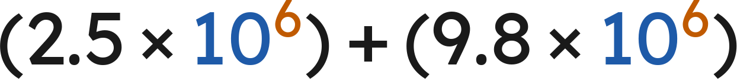

Whiteboards · Question 6 of 9
Which is the sum, written in scientific notation?
Answer: D — 1.23 × 10⁷
Grade 7 Accelerated · Unit 4 · Lesson 1 — Adding and Subtracting in Scientific Notation
26

Slide 27
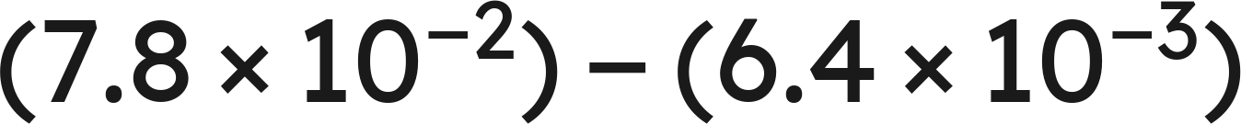
Whiteboards · Question 7 of 9
Answer it.
Grade 7 Accelerated · Unit 4 · Lesson 1 — Adding and Subtracting in Scientific Notation
27

Slide 28
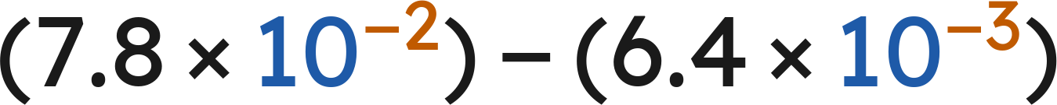


Whiteboards · Question 7 of 9
Match the powers:
Answer: 7.16 × 10⁻²
Grade 7 Accelerated · Unit 4 · Lesson 1 — Adding and Subtracting in Scientific Notation
28

Slide 29

Whiteboards · Question 8 of 9
What is the value of
?
Answer it.
Grade 7 Accelerated · Unit 4 · Lesson 1 — Adding and Subtracting in Scientific Notation
29

Slide 30

Whiteboards · Question 8 of 9
What is the value of
?
Answer: n = 5.7
Grade 7 Accelerated · Unit 4 · Lesson 1 — Adding and Subtracting in Scientific Notation
30

Slide 31
Whiteboards · Question 9 of 9
Devon writes
.
Name the two mistakes he made, and give the correct sum.
Write your answer in sentences.
Grade 7 Accelerated · Unit 4 · Lesson 1 — Adding and Subtracting in Scientific Notation
31

Slide 32
Whiteboards · Question 9 of 9
Devon writes
.
Name the two mistakes he made, and give the correct sum.
The powers do not match, and exponents are not added.
, so
Answer: 3.413 × 10⁵
Grade 7 Accelerated · Unit 4 · Lesson 1 — Adding and Subtracting in Scientific Notation
32

Slide 33
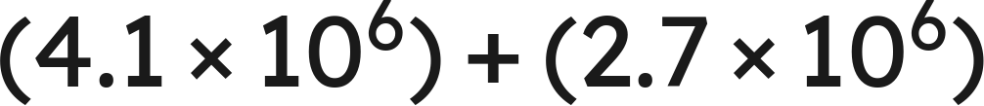
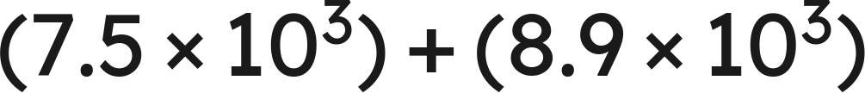
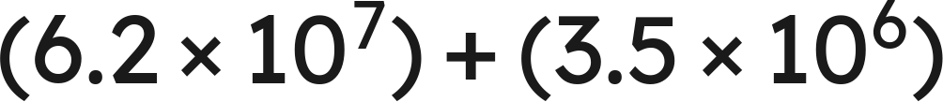

Independent Set
1.
2.
3.
4.
5.
6.
Find
.
Grade 7 Accelerated · Unit 4 · Lesson 1 — Adding and Subtracting in Scientific Notation
33

Slide 34
IXL
1.
Open IXL and start today's skills.
2.
Work on paper where the question needs work. The answer box does not show it.
3.
Every skill listed is required, to a SmartScore of 67. Due at the start of the next class.
Today's skills — all required
Add and subtract numbers written in scientific notation — HUR
Grade 7 Accelerated · Unit 4 · Lesson 1 — Adding and Subtracting in Scientific Notation
34

